Slide 1
1983 computer crisis
Белянский Александр ИC/б-18-2-о

Slide 2

In the 80s videogames were a very lucrative business as in our time. Atari (American game company) was an vanguard of game industry, they had a big financial support from Warner communication (Warner Media). Atari was a leader in the home console market. This company had more competitors, but Atari was one step ahead always.

Slide 3
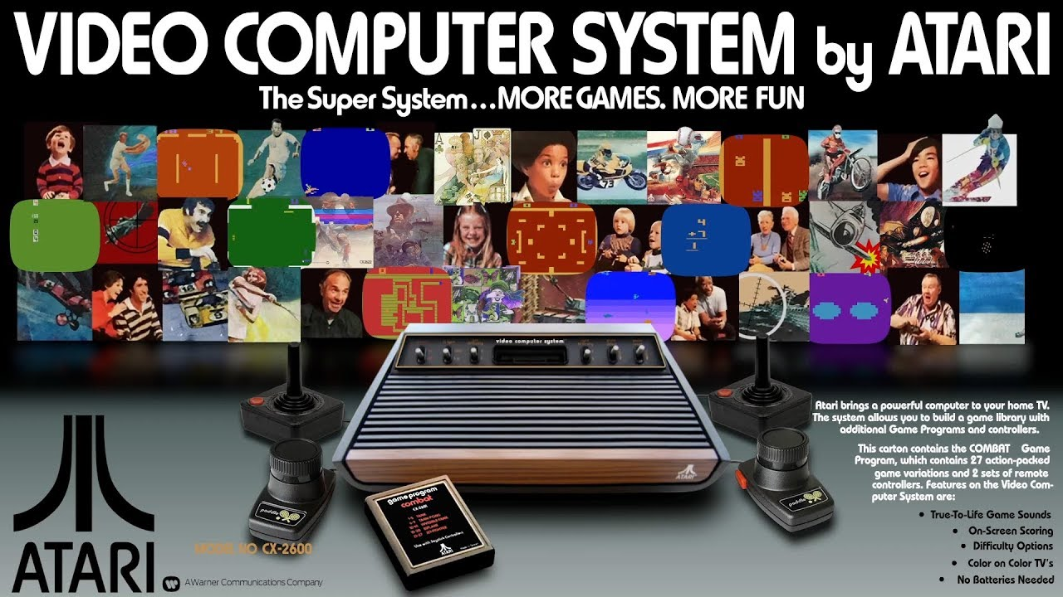
Video Computer System was the most popular Atari console. Aggressive marketing and many kind of games provided so big product demand that there were not enough cartridges for VCS. As a result, many third-rate cartridges on store shelves began to appear. There was no control over the development and release of videogames.

Slide 4
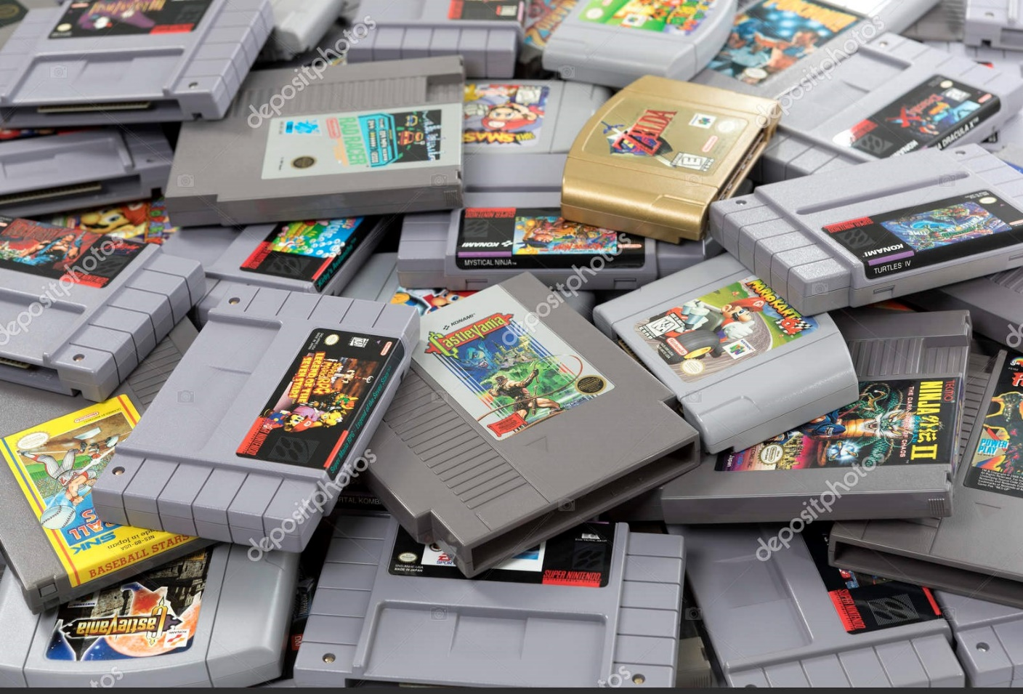
There were good games too, but they were lost among bad products.
In 1982 quantity of videogames for VCS doubled. In 1983 it doubled again. Stores was filled with games, but no one bought them, revenue fell down.

Slide 5
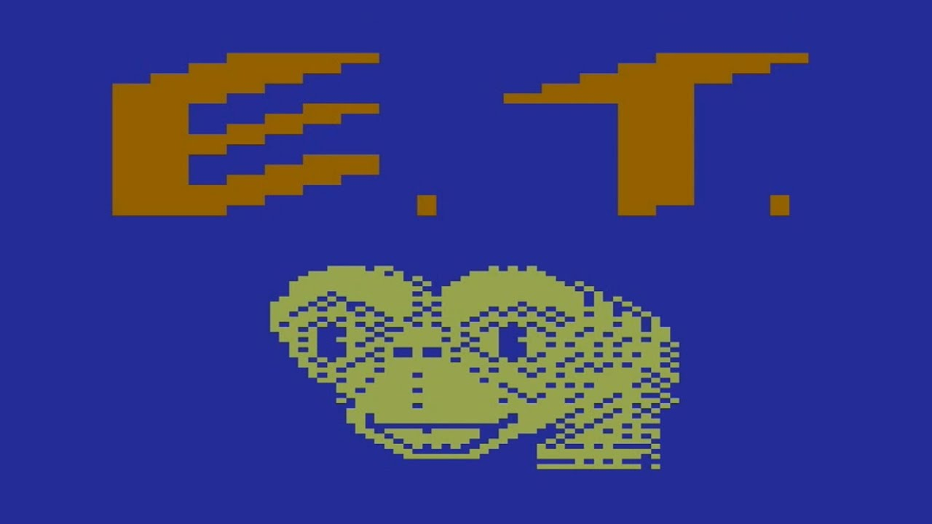
But Atari didn’t worry, because they had a lot of money anyway.
In 1983 “PACMAN” released on VCS and this was a very bad game. This game had an awful graphic and terrible song, “PACMAN” was worse then its arcade version. Then Atari released many bad games like “Raiders of the lost arc” the worst game ever – “E.T. The extra-terrestrial”

Slide 6
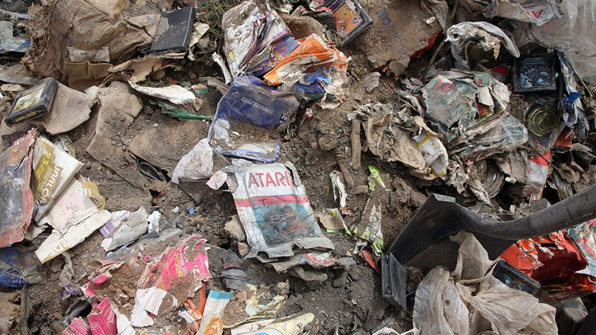
“E.T. The extra-terrestrial” was made to make money only. But nobody wanted to buy it, because it was an awful game. It was a critical point of Atari history.
1982 – VCS stopped selling, cartridges returned, stock price fell. Confidence in game industry has disappeared. The revenue fell from $3.2 billion (1983) to $100 million (1985). All cartridges were sent to landfill in 1983. It was mass grave of videogames.

Slide 7
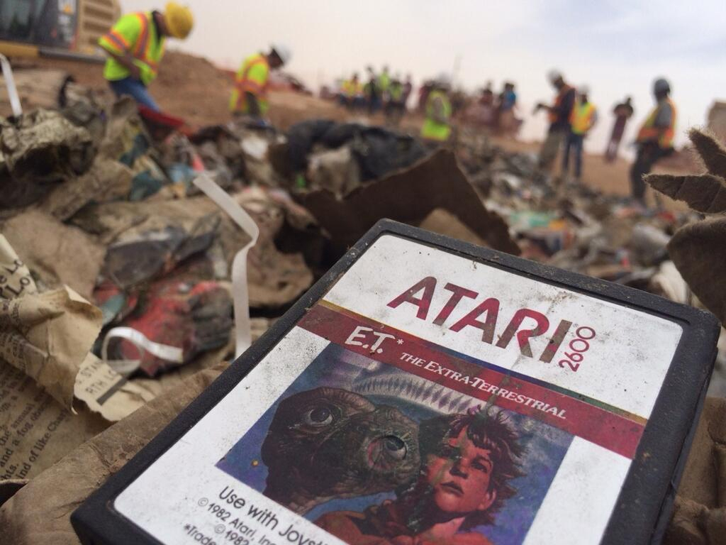

Slide 8
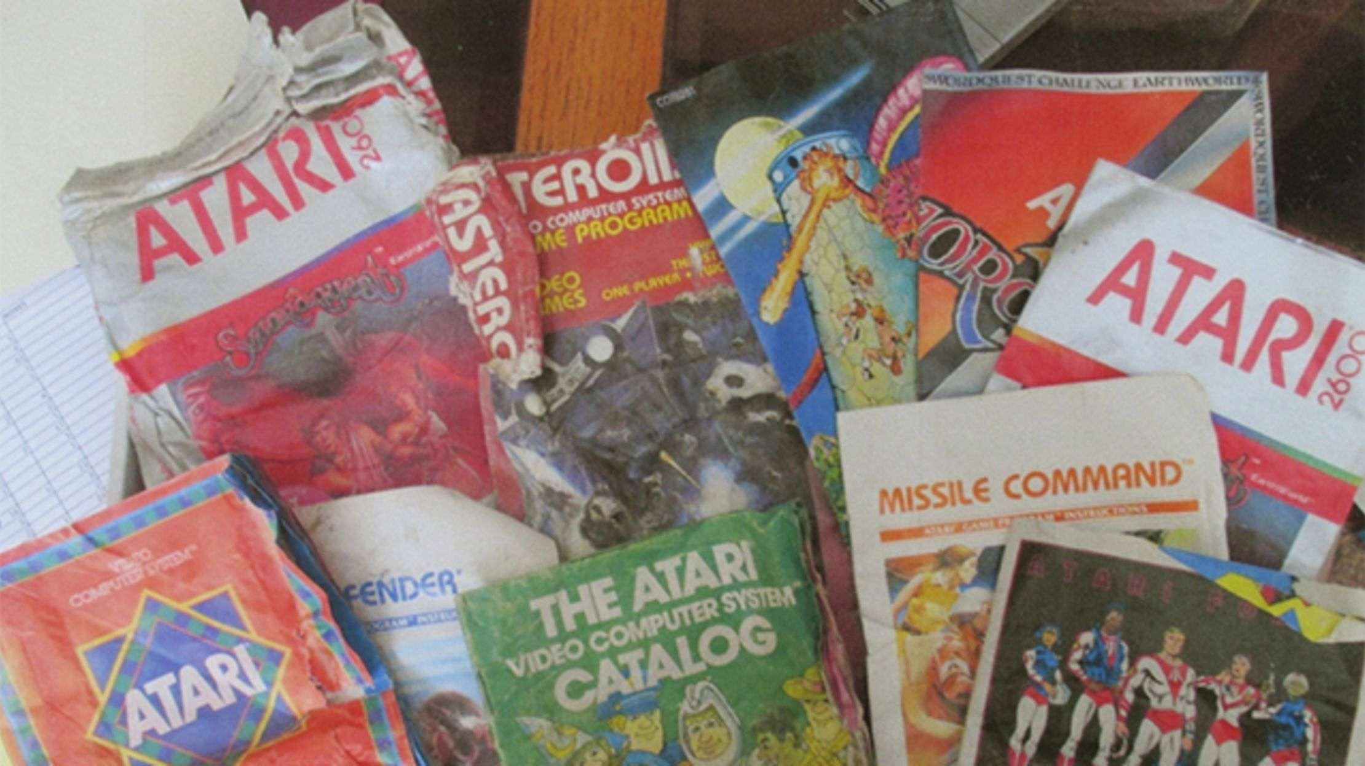
Gaming industry couldn’t recover from the crisis for a long time. Only a few years later, European and Japanese game companies (“SEGA” and “Nintendo” ) began to revive the industry and regain the confidence of gamers.
That is how the greed of one company and uncontrolled production of videogames nearly ruined the huge entertainment industry

Slide 9
Thanks for your attention!

